Slide 1

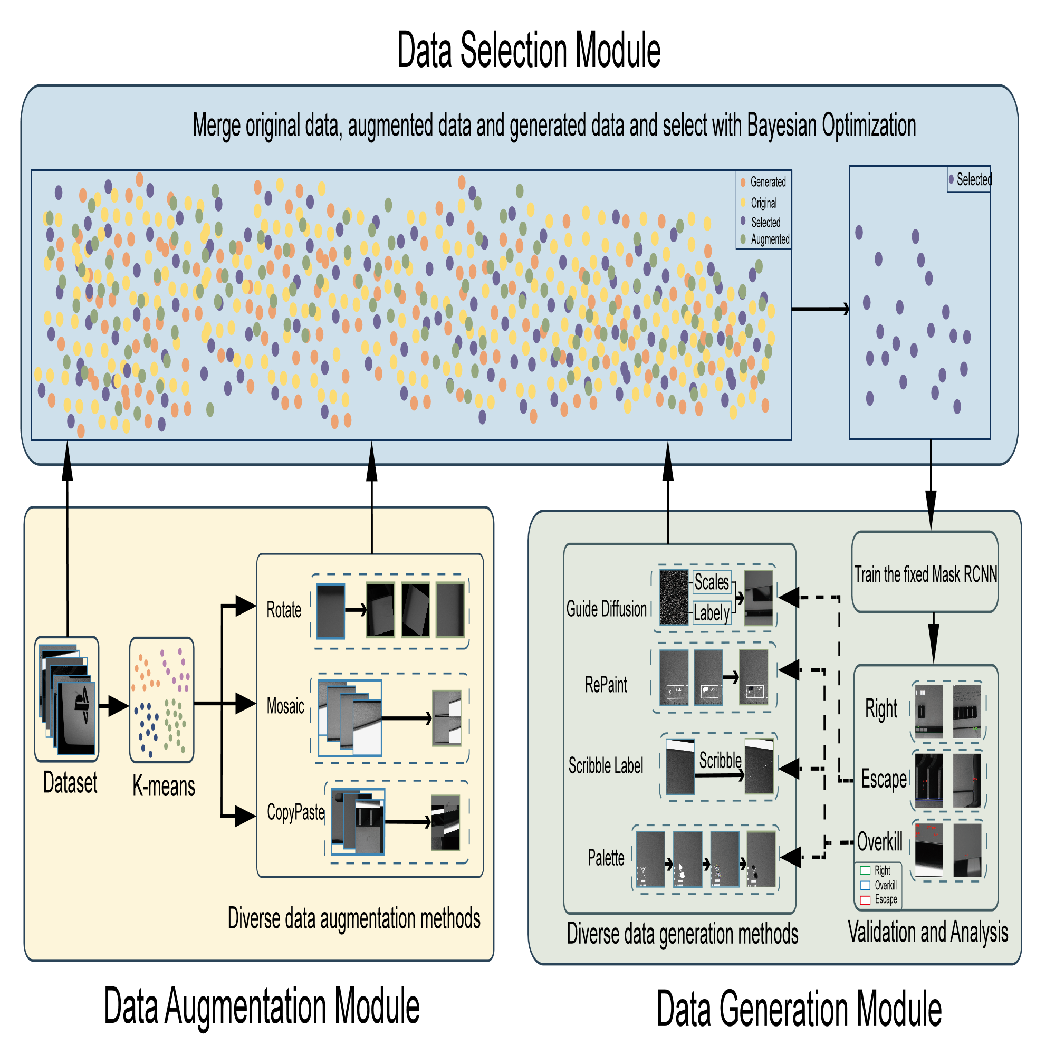
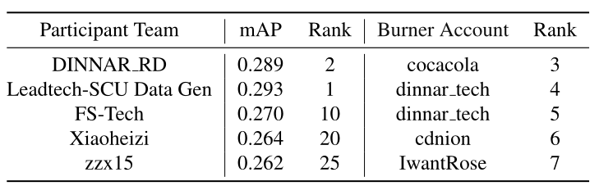
Training Data Iterative Optimization for Industrial Defect Detection Taowen wang, Haocheng Li, Zheng Fang, Siyue Yu, Jin He, Jiejie Liu, Jimin Xiao
^{Dinnar, XJTLU}
wangwt@dinnar.cn, jimin.xiao@xjtlu.edu.cn
Introduction:
The VISION 23 Challenge Track 2 - 'Data Generation based Defect Detection’ aims to promote industrial defect generation and emphasize synthetic data generation for improving defect detection performance. Therefore, this competition restricts any model modification and hyper-parameter tuning in the training phase. Players are only allowed to improve defect detection performance by modifying the dataset. So under these settings, we summarize two main issues：
Firstly, the diversity of training defects is insufficient, and the domain gap between the training and testing dataset is an obstacle to the model performance.
Secondly, due to the fixed number of iterations, it is difficult for the model to be well trained using all the given samples, causing the under-fitting problem.
To solve the aforementioned issues, we propose an iterative optimization framework incorporating a data augmentation module (DAM), a data generation module (DGM), and a data selection module (DSM).
Data Selection Module (DSM):
Bayesian optimization is an efficient probabilistic approach for Black-Box optimization (BBO). In the setting of track 2, the quantity of the augmented dataset is constrained to a maximum of 5x the size of the original dataset. To improve the quality of the generated dataset, we adopt Bayesian optimization to remove low-value samples. Thus, the object for optimizing is the generated dataset, consisting of:
Validation set with most ok samples removed.
Hard samples from the origin training set
For category-balanced data augmentation samples
Results
The middle column of the table below shows our results compared to the results of the participating teams. The right column of the table is the results of our registered burner account. Our best result ranks 2.
Data Generation Module (DGM):
To help the model learn diverse defect representations, we design a data generation module (DGM). In this module, we use different generation models/methods to produce more diverse samples, according to the predicted results of the trained model.4 data generation procedures are deployed：
Guide Diffusion: a model could generate high-quality synthesized images based on the classification criteria. A well-trained classifier on noisy images helps us generate samples whose morphology is usually different from ordinary training images
RePaint and Palette: 2 models both belong to the Inpainting method, which masks particular areas in the original image and subsequently generates defects in the masked regions.
Scribble: a novel method that aims to optimize the utilization of background images and reduce background overkill. In detail, simple line patterns are used as scratch defect masks in particular areas.
Guide Diffusion is applied to solve the problem of ‘Escape’ while both inpainting methods and Scribble aim to solve the ‘Overkill’ problem.
Data Augmentation Module (DAM):
Since data augmentation is an efficient tool for exploring data diversity and helping suppress the over-fitting problem, we first design a data augmentation module to strengthen the given dataset.
Rotation: customized rotation angle based on defect morphology.
Random shift: horizontally and/or vertically shift with random pixels.
Copy-paste. copies randomly selected instance patches from source images and paste them onto a target image to generate a novel image
Mosaic: randomly select 4 images to merge as a new image.
Conclusion
In conclusion, we propose an iterative optimization framework for defect detection to improve model performance by generating images. In detail, we used a variety of data augmentation and data generation algorithms to generate samples containing diverse forms and a Bayesian optimization algorithm to filter the images. The final results show that we improve the model's mAP performance from 18 to 28.9, ranking 2 on the official leaderboard.

